Slide 1
Make FunBlocks alive
Marvin FOURASTIE
Master project
<number>

Slide 2




Motivations
Educational purpose
Imperative paradigm alternative
Based on rewrite systems
FunBlocks
<number>
Notes:
Educ purpose :
- concept of programming (data structures, state, calculabilité/complexité)
- Automation of solving a task
Alternative :
- Focus on the nature of the problem (“what”)
- explicit state of the problem
Rewrite system :
- Intuitive model for state transformation
- Declarative -> better look at computability theories
<number>

Slide 3
Road Map
February 2021
June 2021
State of the art
Test existing tools
Implementation
Report writing
95 jours
81 jours
2020
<number>
Notes:
<number>

Slide 4
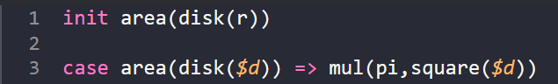
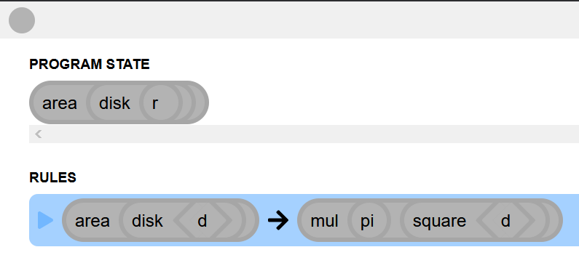
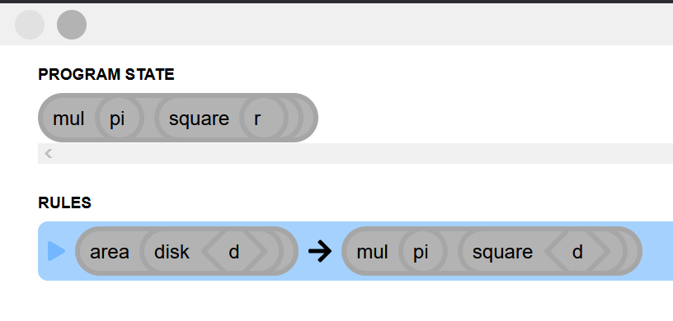
FunBlocks
<number>
Notes:
Init -> state of the program
Case -> rewrite system
<number>

Slide 5
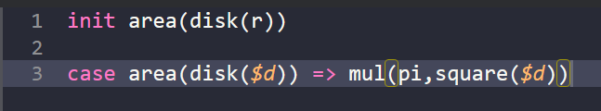
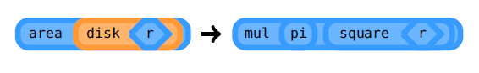
FunBlocks
Declarative paradigm
Based on rewrite systems
Static typing
<number>
Notes:
Declarative -> terms (literal/constants, variables, functions)
Rewrite -> steps for state transformations
Static -> untype/typed by function/explicitly typed
<number>

Slide 6
Goals
Provide users with valuable insights about their program
Verification of rewrite systems
<number>
Notes:
Valuable insights -> indice pour écrire le program correctement
<number>

Slide 7
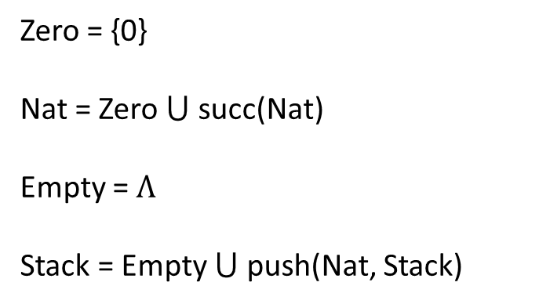
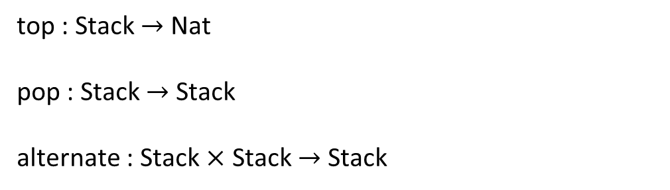
Rewrite systems
Stack operators
Zero = {0}
Nat = Zero succ(Nat)
Empty =
Stack = Empty push(Nat, Stack)
top : Stack Nat
pop : Stack Stack
alternate : Stack Stack Stack
<number>
Notes:
Top -> first element
Pop -> remove first
Alternate -> merge 2 stacks
<number>

Slide 8
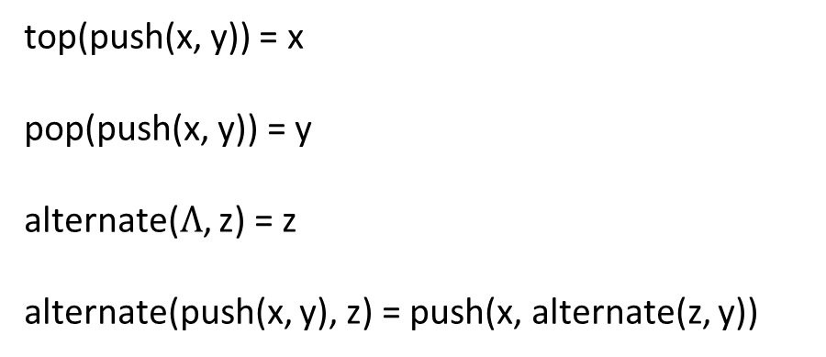
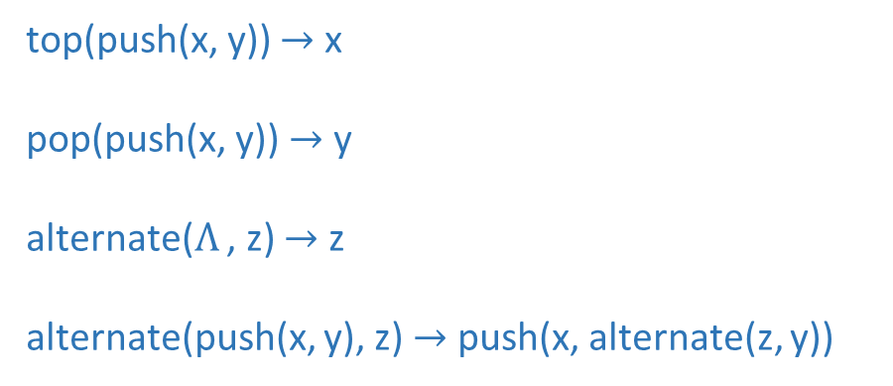
Rewrite systems
Canonical rewrite system
top(push(x, y)) = x
pop(push(x, y)) = y
alternate(, z) = z
alternate(push(x, y), z) = push(x, alternate(z, y))
top(push(x, y)) x
pop(push(x, y)) y
alternate( , z) z
alternate(push(x, y), z) push(x, alternate(z, y))
<number>
Notes:
The central idea of rewriting is to impose directionality on the use of equations in proofs
Evaluer les termes
Pas forcément de mapping direct
<number>

Slide 9
Rewrite systems
Termination
Confluence
Soundness
Completeness
Correctness
Undecidable in general
<number>
Notes:
Five desirable properties involved in the verification of rewrite systems
are:
(1) termination--no infinite derivations are possible,
(2) confluence--each term has at most one normal form,
(3) soundness--terms are only rewritten to equal terms, (the equation l = r is valid in E)
(4) completeness--equal terms have the same normal form,
(5) correctness--all normal forms satisfy given requirements.
<number>

Slide 10
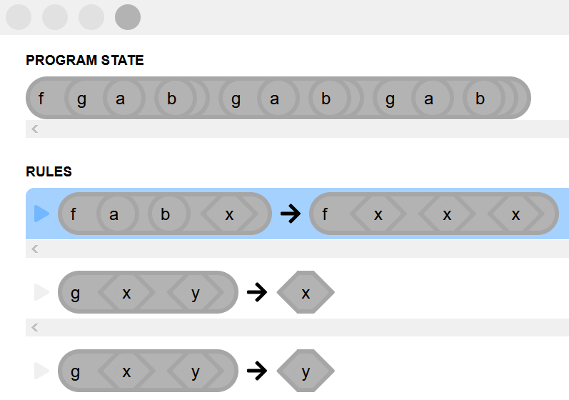
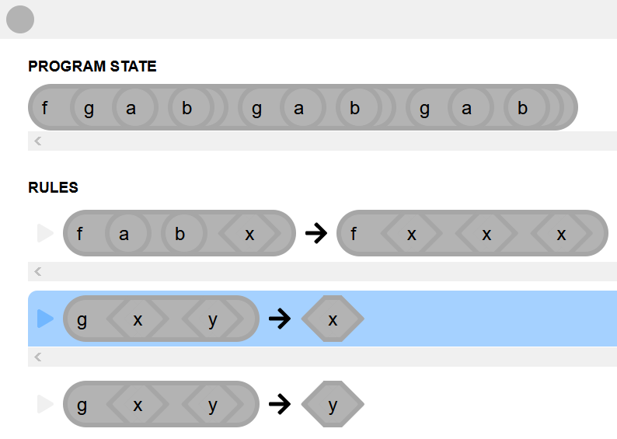
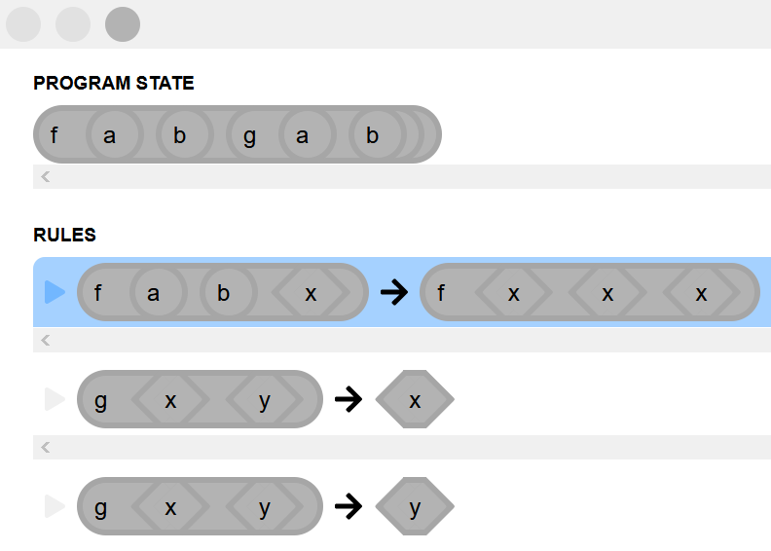
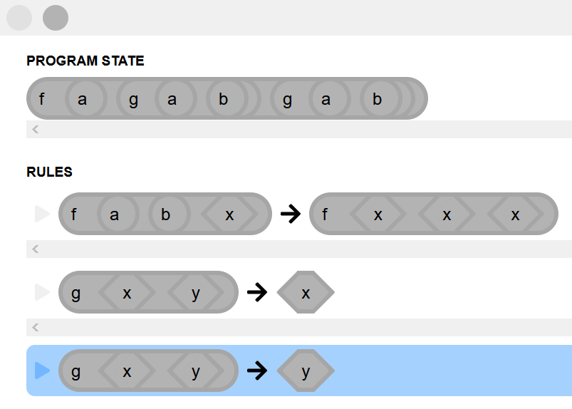
Termination
Initial state
<number>

Slide 11
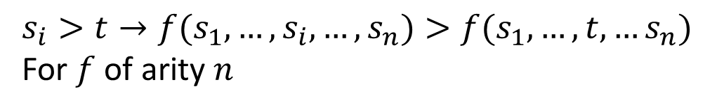
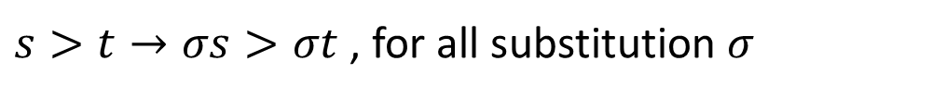
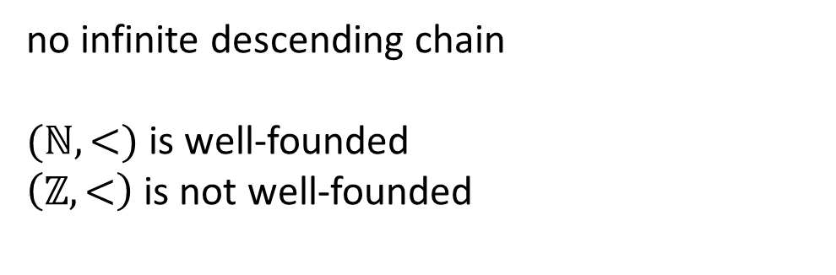
Reduction order
Monotone
Close under substitution
Well-founded
For of arity
, for all substitution
no infinite descending chain
is well-founded
is not well-founded
<number>
Notes:
Well-founded -> toujours comparable et plus petit élément (no infinite descending chain)
Well-founded -> toujours comparable et ∃ plus petit élément (no infinite descending chain)
<number>

Slide 12
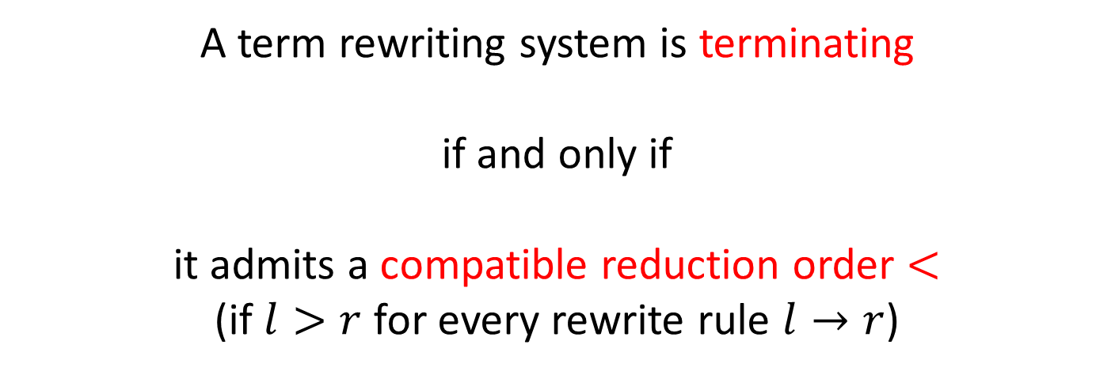
Termination
A term rewriting system is terminating
if and only if
it admits a compatible reduction order
(if for every rewrite rule )
Verification of termination
<number>
Notes:
<number>

Slide 13
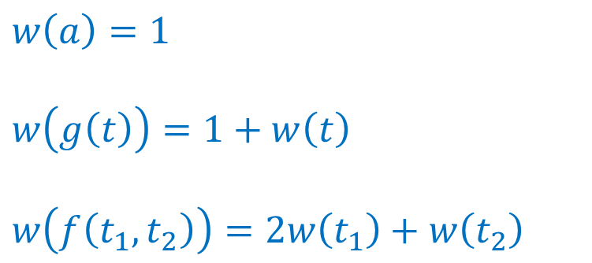
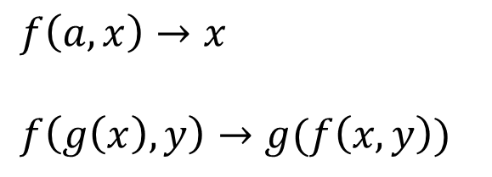
Polynomial interpretation
weight
<number>
Notes:
Each term mapping to polynome
<number>

Slide 14
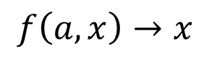
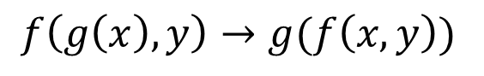
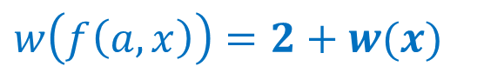

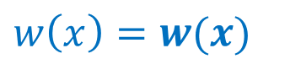




Polynomial interpretation
Reduction order Termination
<number>
Notes:
<number>

Slide 15
Algorithms
Recursive Path Ordering
Knuth-Bendix Ordering
Dependency pairs
Order based on the mutisets
Based on weights assigned to operators
Prove innermost termination
<number>
Notes:
RPO variante = LPO => ordre lexicographique sur les arguments
compare left-hand sides
with special subterms of the right-hand sides -> create dependency pairs -> detect infinite chaining
<number>

Slide 16


Termination
Direct proof
(polynomial, LBO, KBO,…)
Dependency pairs and size-change principle
<number>
Notes:
If every infinite computation would give rise to an infinitely decreasing value sequence (according to the size-change graphs), then no infinite computation is possible
<number>

Slide 17
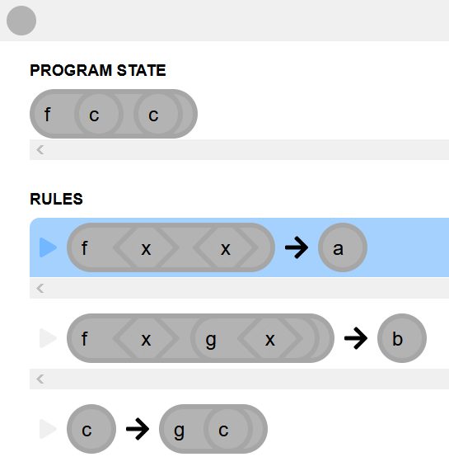
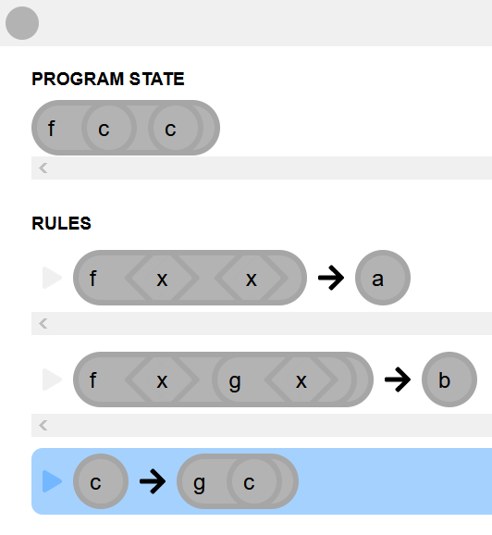
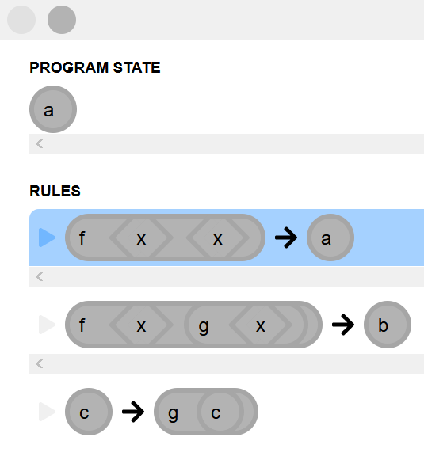
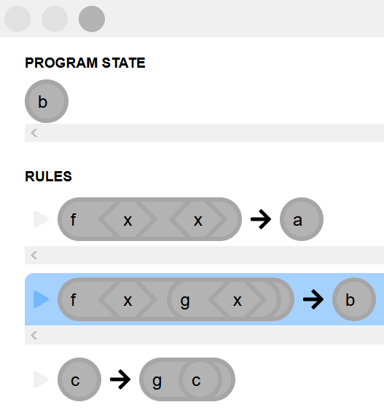
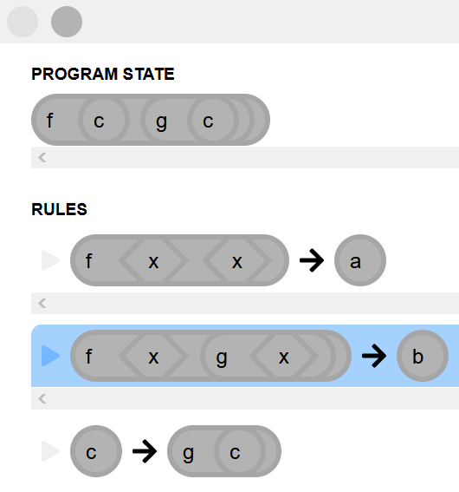
Confluence
<number>

Slide 18
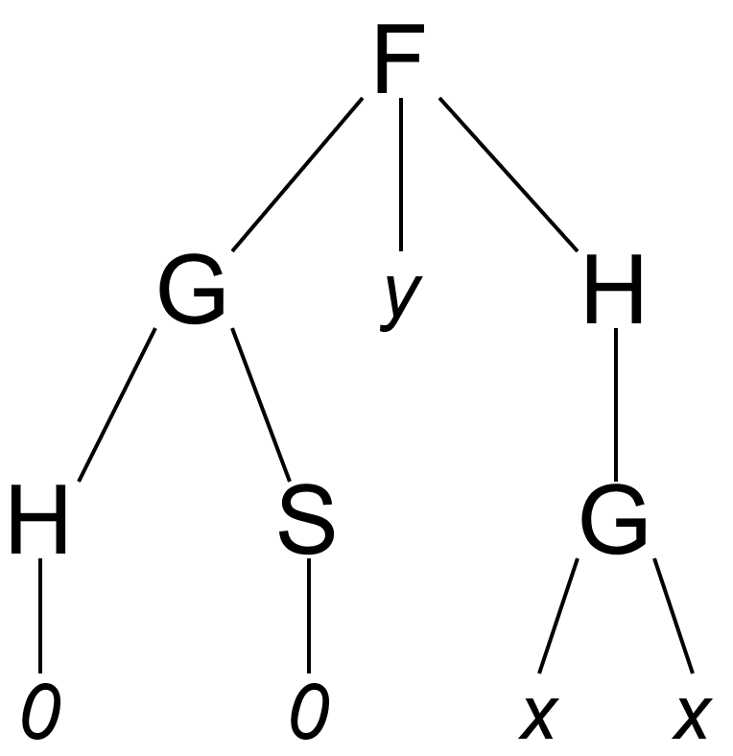
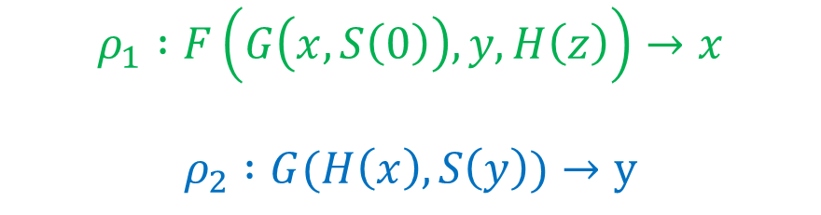
Overlap and critical pairs
<number>
Notes:
Overlapping existing with these rules
<number>

Slide 19
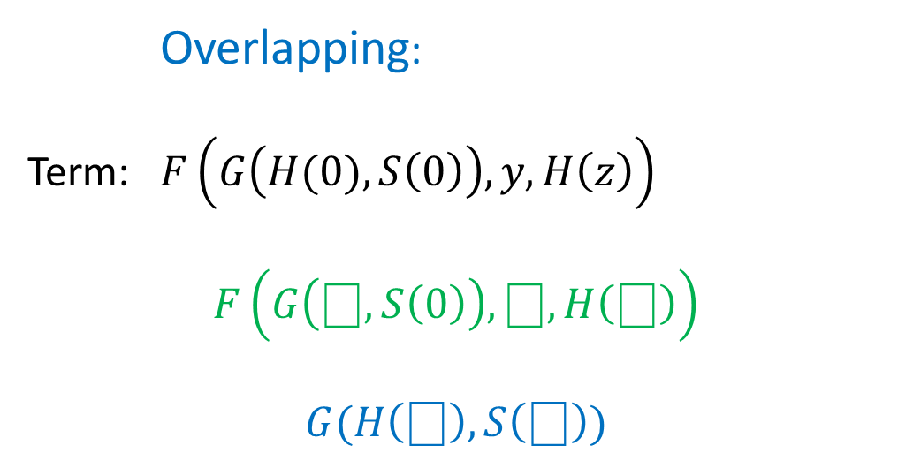
Overlap and critical pairs
Overlapping:
Term:
<number>
Notes:
Term initial -> can apply rules on same terms
<number>

Slide 20
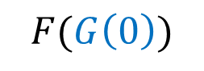
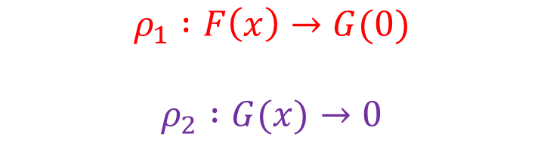
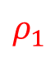
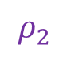
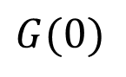
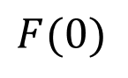
Overlap and critical pairs
Overlapping
is called critical pair
<number>
Notes:
Critical pair: x et le terme F(G(x)) avec substitution p2
Divergent + non-confluent
<number>

Slide 21
Critical Pair Lemma
A terminating rewriting system is confluent
if and only if
all critical pairs are convergent
<number>
Notes:
Bleu = condition
<number>

Slide 22
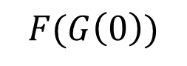
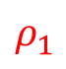
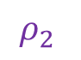
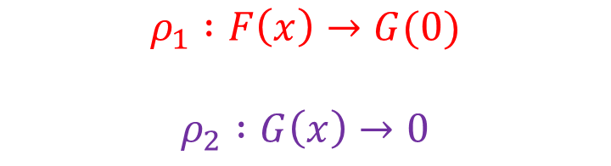
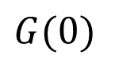
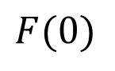
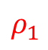
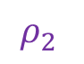
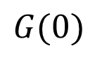
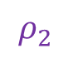

Critical Pair Lemma
Convergence
<number>
Notes:
Algorithm pour verifier la confluence d’un TRS
Compute all canonical form of each term and verify s(t1) = s(t2)
<number>

Slide 23
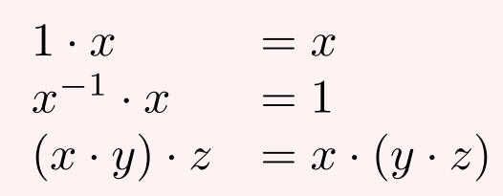
Knuth-Bendix completion
Input:
A set of equation
A reduction ordering <
Non-confluent
<number>
Notes:
Create a system confluent and terminating
Ordre de reduction < (each term is rewrote “simpler”)
Spécification des groups multiplicatifs
<number>

Slide 24
Knuth-Bendix completion
Output:
Terminate successfully
Loop indefinitely
Fail
Terminating and confluent rewrite system
Non-terminating rewrite system
Rule which cannot be ordered
(i.e. commutative operator)
<number>
Notes:
Create a system confluent and terminating
Ordre de reduction < (each term is rewrote “simpler”)
Spécification des groups multiplicatifs
<number>

Slide 25




Knuth-Bendix completion
Basic rules:
Orienting
Adding
Simplifying
Deleting
Transform to
Add in the set of equation
Simplify in
Delete trivial rules
<number>
Notes:
Simplifying -> use of critical pairs and orientation
<number>

Slide 26

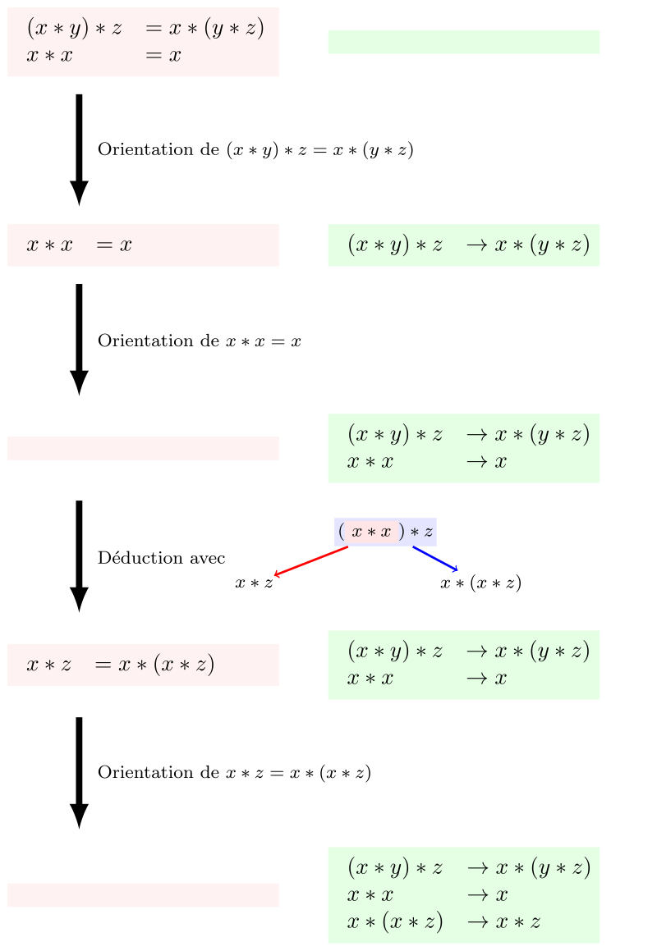
Knuth-Bendix completion
Adding
Add in the set of equation
New rule added
No convergent
<number>
Notes:
Simplifying -> use of critical pairs and orientation
Overlapping and divergence (impossible to converge)
<number>

Slide 27
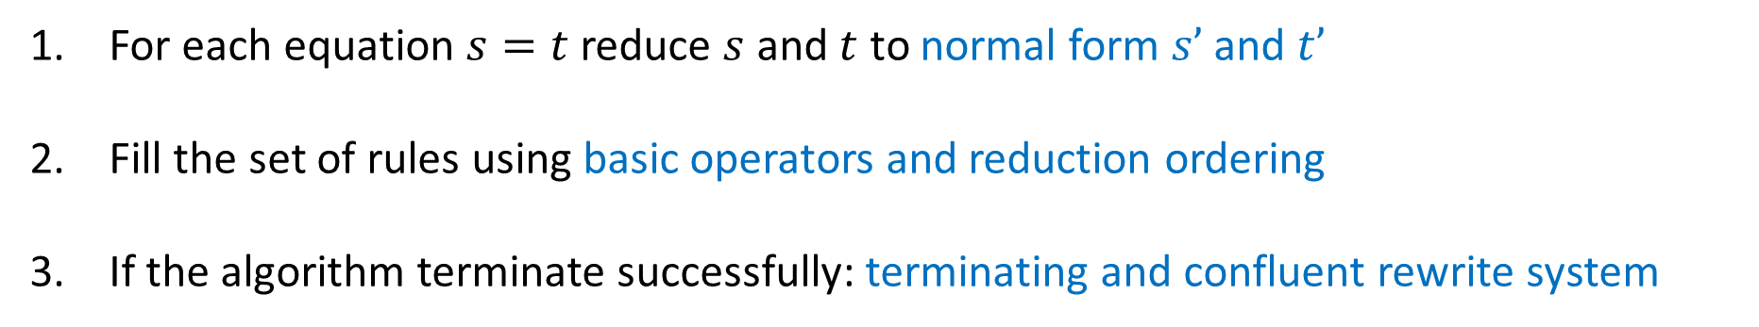
Knuth-Bendix completion
Completion process:
For each equation reduce and to normal form and
Fill the set of rules using basic operators and reduction ordering
If the algorithm terminate successfully: terminating and confluent rewrite system
<number>
Notes:
Set of equation -> TRS
<number>

Slide 28
Knuth-Bendix completion
Completion for axioms of groups:
<number>
Notes:
Set of equation -> TRS
<number>

Slide 29


Educational tools
CSI
KBCV
Termination
Confluence
Completion
<number>
Notes:
<number>

Slide 30

TRS tool
<number>
Notes:
<number>

Slide 31


TRS tool
<number>
Notes:
<number>

Slide 32

TTT2
<number>
Notes:
Output yes or no + trace of the proof
<number>

Slide 33

CSI
<number>
Notes:
Langage hrs
<number>

Slide 34

KBCV
<number>
Notes:
Kbcv (Knuth-Bendix Completion Vizualizer)
<number>

Slide 35


Performance tools
Termination
Confluence
Completion
Proof verification
MU-TERM
ACP
CoLoR
NaTT
Saigawa
<number>
Notes:
But: terminations contest, completion contest
Mu-term used by mtt, web interface
<number>

Slide 36


Hybrid tools
<number>
Notes:
<number>

Slide 37


CiME
Rewriting toolkit
Proof engine
Proof certification
<number>
Notes:
Rewriting toolkit: créer et traiter des TRS
Proof : effectuer des preuves (termination, confluence,…)
Certification: get the proof in a standard file -> coq pour la preuve
<number>

Slide 38

CiME
<number>
Notes:
Use cime or alternate prover
Get the trace of the proof
Put in coq/coccinelle for output in standard file
<number>

Slide 39
CiME
Examples of declarations
let X = variables “x,y”;
let F = signature “plus : binary; 0:constant; S:unary;”;
let T = algebra F;
let t1 = term T “S(0)”;
let R = trs T “plus(0,x) -> x; plus(S x, y) -> S(plus(x,y));”;
let c = order_constraints T “0 < S(0) /\ S(plus(x,y)) < plus(S(x),y)”;
<number>
Notes:
Order constraints : order operators
<number>

Slide 40
CiME
Definition of signatures
CiME> let F_peano = signature “
0 : constant; s : unary; +,* : infix binary;
";
F_peano : signature = signature "* : 2; s : 1; + : 2; 0 : 0"
CiME>let X = variables "x,y,z";
X : variable_set = variables "z,x,y"
<number>
Notes:
<number>

Slide 41
CiME
Definition of algebra and terms
CiME> let A_peano = algebra F_peano ;
A_peano : F_peano algebra = algebra F_peano
CiME> let t = term A_peano "s(s(s(0)))*(s(0)+s(s(0)))";
t : F_peano term = s(s(s(0))) *(s(0)+s(s(0)))
<number>
Notes:
<number>

Slide 42
CiME
Term rewriting system
CiME> let R_peano = trs A_peano “
x+0 -> x;
x+s(y) -> s(x+y);
x*0 -> 0;
x*s(y) -> (x*y)+x;
";
R_peano : F_peano trs = trs A_peano “
x+0 -> x;
x+s(y) -> s(x+y);
x *0 -> 0;
x *s(y) -> (x *y)+x "
CiME> termination R_peano;
CiME> coq_certify_proof R_peano;
CiME> convergence R_peano ;
…
<number>
Notes:
Convergence -> termination + confluence
<number>

Slide 43



Maude
Simplicity
Expressiveness
Performance
<number>
Notes:
Simplicity: based on rewrite system, simple syntax as funblock (modules)
Expressiveness: formalisms, other languages, and other logics can be naturally expressed.
Maude should be viewed as a high-performance metalanguage, through which many different domain-specific languages can be developed
Tools!!!
Performance: concrete implementations should yield system performance competive with other efficient programming languages
<number>

Slide 44

Maude
<number>
Notes:
Functional module:
- sort: type declared
- op: name , domain , co-domain (surcharge possible)
- vars: variable declaration
- eq: unconditionnal equation (conditionnal with ceq)
<number>

Slide 45

Maude
> load factorial.maude
> red 100 ! .
Reduce in FACTORIAL : 100 ! .
rewrites: 201 in 0ms cpu (0ms real) (~ rewrites/second)
result NzNAT: 93326215443944152681699238856266700490715968264381621468592963895217599993229915608941463976156518286253697920827223758251185210916864000000000000000000000000
<number>
Notes:
<number>

Slide 46

Maude
<number>
Notes:
System module:
- including -> functional module (use as a signature)
- variable
- unconditional rules (conditional with crl)
<number>

Slide 47
Maude
Inductive Theorem Prover (ITP)
Sufficient Completeness Checker (SCC)
Church-Rosser Checker (CRC)
Coherence Checker (ChC)
Maude Termination Tool (MTT)
Maude Formal Environment (MFE)
<number>
Notes:
ITP : Inductive theorem proving
SCC : Completeness of rewrite system
CRC : confluence (equational)
ChC : confluence (rewrite spec)
MTT : termination
PB: modules écrit indep, problèmes de version, compatibilite, peu maintenu
<number>

Slide 48

Tools overview
 | Maude | CiME
Extensibility
Still active
I/O files
Syntax
Documentation
<number>
Notes:
Extensible : use for other applications
- Maude: meta-languege for dsl
- CiME : yes by the use of xml-based file but not created for this purpose
Still Active: last release
- Maude 3.1 (October 2020); MFE (last release in 2016)
- CiME3 (2010) , CoLoR (2018)
I/O files: récupérer sortie et erreurs
- Maude : output formatting
- CiME : stadard input output (xml, .v, coq files)
Syntax
- Quite simple
<number>

Slide 49



I/O in Maude
Standard input/output
File handling
Sockets
<number>
Notes:
Standard input/output/error (erew)
File handling (read/write mode)
Socket handling
<number>

Slide 50
I/O in Maude
<number>
Notes:
Rules:
add-q : insérer 0.25 $
add-$ : insérer 1$
buy-c : 1$ => 1 cake
buy-a : 1$ => 1 apple + 0.25$
change : 4*0.25$ => 1$
<number>

Slide 51

I/O in Maude
<number>
Notes:
Acheter des objets dans un distributeur automatique
Signature des actions de la vending machine (1$, 0.25$, apple, cake)
Coin item subsort of marking
<number>

Slide 52

I/O in Maude
<number>
Notes:
language for interacting with the vending machine
Extending signature
<number>

Slide 53


I/O in Maude
<number>
Notes:
Rule : affiche « one dollar introduced » quand insertCoin appelé
OO programming, conf <obj : class, attributs>
Vm : const vending machine
File: read, write, …
Idle : const action waited from input
<number>

Slide 54
I/O in Maude
Enter in external environment
Maude> erew vending machine .
erewrite in VENDING-MACHINE-IO : vending machine .
> insert $
one dollar introduced
> buy 1 a(s)
1 apples bought
Input
Output
Parse input?
<number>
Notes:
Erew pour entrer dans l’env ext
Get correct input? <=> parse input?
<number>

Slide 55



META-LEVEL module
Parse input
Execute
Print
<number>
Notes:
Native in Maude
Parse input, execter avec rules given, print (colors, standard error,…)
<number>

Slide 56
META-LEVEL module
META-LEVEL
META-TERM
META-MODULE
META-STRATEGY
META-VIEW
<number>
Notes:
Meta-term: Sort and Kind (getName, getType)
Meta-strategy: strategy, order, …
Meta-module (import meta-term): get member of the module (rules, eq, op,…)
Meta-view : structure de donnée view
<number>

Slide 57
META-LEVEL operations
metaParse()
upModule()/downModule()
Reduce in META-LEVEL
Parse a metarepresentation
Move through metarepresentations
Use operation of the META-LEVEL module
<number>
Notes:
metaParse:
Up: get metarepresentation / down: get canonical form (terms, op, eq, ax…)
<number>

Slide 58
Metalanguage
Funblocks
init area(disk(r))
case area(disk($d)) => mul(pi,square($d))
Maude
sorts Const Var Func State Rule Term Expr .
<number>
Notes:
Syntaxe + sorts incomplets
<number>

Slide 59
Metalanguage
case f($x) => a
Bubble
Token
‘case ‘f ‘( ‘$ ‘x ‘) ‘=> ‘a
Tokens are represented by quoted identifiers (QID)
<number>
Notes:
<number>

Slide 60


Metalanguage
> result: {‘case_=>_[bubble[…]],bubble[‘a.Qid]],’Rule}
<number>
Notes:
Parsing grossier: pas de typage dans les bubbles
<number>

Slide 61
MINI-MAUDE
mini-maude
syntaxe
mini-maude
(semantic)
mini-maude
metainterpreter
File
MetaInterpreter
<number>
Notes:
File: get input/output, read/write..
MetaInterpreter: operation of interpreter
<number>

Slide 62
MINI-MAUDE
Maude> erew minimaude .
erewrite in MINI-MAUDE-META-INTERPRETER : minimaude .
MiniMaude Execution Environment
minimaude> fmod NAT3 is
> sort Nat3 .
> op s_ : Nat3 -> Nat3 .
> op 0 : -> Nat3 .
> eq s s s 0 = 0 .
> endfm
Module loaded successfully
minimaude> reduce s s s s 0 .
result Nat3: s 0
<number>
Notes:
<number>

Slide 63

System diagram
Maude environment
FILE + META-LEVEL + MFE
Read file + parse + verify
Funblocks
code
input
output
Output in shell or IDE
<number>
Notes:
<number>

Slide 64

FILE + META-LEVEL + MFE
Read file + parse + verify
Verify syntax and semantic of the input
Start checker environment in a shell
Get commands and verify properties
input
Read FunBlocks file
output
<number>
Notes:
<number>

Slide 65

Verify syntax and semantic of the input
Start checker environment in a shell
Get commands and verify properties
input
Read FunBlocks file
output
FunBlocks file
Read file
FILE
openFile()
getLine()
…
Input
Output
<number>
Notes:
<number>

Slide 66

Verify syntax and semantic of the input
Start checker environment in a shell
Get commands and verify properties
input
Read FunBlocks file
output
Read file
META-LEVEL
Module inserted
metaParse()
upModule()
…
Input
load funblocks-syntax.maude
load funblocks-semantic.maude
Output
<number>
Notes:
<number>

Slide 67
Verify syntax and semantic of the input
Start checker environment in a shell
Get commands and verify properties
input
Read FunBlocks file
output
Module inserted
META-INTERPRETER
Wait for input
createInterpreter()
insertModule()
…
Input
Output
<number>
Notes:
<number>

Slide 68
Verify syntax and semantic of the input
Start checker environment in a shell
Get commands and verify properties
input
Read FunBlocks file
output
MFE
(Maude Formal Environment)
Get command
Print in shell
termination()
confluence()
…
Input
Output
<number>
Notes:
<number>

Slide 69
FunBlocks checker system
funblocks-syntax
funblocks
(semantic)
funblocks-metainterpreter
<number>
Notes:
File: get input/output, read/write..
MetaInterpreter: operation of interpreter
<number>

Slide 70

funblocks-metainterpreter
<number>
Notes:
<number>

Slide 71
funblocks-metainterpreter
<number>
Notes:
<number>

Slide 72

Mini-Maude: insert module
<number>
Notes:
<number>

Slide 73

Mini-Maude: use « reduce » command
<number>
Notes:
<number>

Slide 74

Mini-Maude: wrong command
<number>
Notes:
<number>

Slide 75

Mini-Maude: quit environment
<number>
Notes:
<number>

Slide 76
Funblocks checker
FunBlocks code
Module inserted
FUN-TO-MAUDE
Input
load funblocks-syntax.maude
load funblocks-semantic.maude
Output
<number>
Notes:
<number>

Slide 77


Funblocks checker
FUN-TO-MAUDE
Input
Output
<number>
Notes:
<number>

Slide 78

What’s next ?
Typing ?
Type checking
<number>
Notes:
Type checking var / const, arity of functions, …
<number>

Slide 79
FunBlocks checker system
User input
User input
User output
fun-to-maude
funblocks-metainterpreter
MFE
funblocks-syntax
funblocks
(semantic)
funrules
<number>
Notes:
<number>

Slide 80

FUNBLOCK-SYNTAX
<number>
Notes:
Term = right term, left term
Token ~ Const
<number>

Slide 81
FUNBLOCKS
‘case ‘$ ‘x ‘=> ‘id ‘( ‘a ‘)
funblocks
(semantic)
‘var ‘‘$'x ‘: ‘Untyped ‘. ‘\n
‘op 'id ‘: ‘Untyped ‘-> ‘Untyped ‘. ‘\n
‘op 'a ‘: ‘-> ‘Untyped ‘. ‘\n
‘rl ‘$'x ‘=> ‘’id ’( ‘‘a ‘) ‘. ‘\n
<number>
Notes:
‘ en plus : postprocessing (Python) aka formatter ?
<number>

Slide 82
FUNBLOCKS
‘case ‘compose ‘( ‘f ‘, ‘g ‘, ‘$ ‘x ‘) ‘=> ‘f ‘( ‘g ‘( ‘$ ‘x ‘) ‘)
funblocks
(semantic)
noParse()
<number>
Notes:
Nested func, constante, n-ary …
<number>

Slide 83

FUN-TO-MAUDE
init dist(a,d)
case $ x => id(a)
fun-to-maude
funblocks-syntax
funblocks
(semantic)
<number>
Notes:
Space after $ => pré formattage ?
<number>

Slide 84

FUNRULES
<number>
Notes:
Module funtype ou les types sont définis
Définir les sorts au moment du parsing dans le module
<number>

Slide 85
Pre-processing (script)
case id($x) => $x
case id($ x) => $ x
<number>
Notes:
Space after $ => pré formattage ?
<number>

Slide 86
Post-processing (script)
case id($’x) => $’x
case id($x) => $x
op a : -> Nat
op a : -> Nat
op a : -> Nat
<number>
Notes:
Space after $ => pré formattage ?
<number>

Slide 87

FUN-TO-MAUDE
file_process
(script)
init dist(a,d)
case $x => id(a)
fun-to-maude
funblocks-syntax
funblocks
(semantic)
<number>
Notes:
Space after $ => pré formattage ?
<number>

Slide 88
FunBlocks checker system
User input
User input
User output
fun-to-maude
funblocks-metainterpreter
MFE
funblocks-syntax
funblocks
(semantic)
funrules
<number>
Notes:
<number>

Slide 89
Static Typing
type List $T :: empty | cons $T (List $T)
rule ajoute $T :: $T -> List $T => List $T
case ajoute($x, cons($y, $tail)) => cons($y, $tail)
{ ajoute:
[ TypeVarRef { range: [Object], label: 'T' },
TypeDeclRef { range: [Object], name: 'List', arguments: [Array] },
TypeDeclRef { range: [Object], name: 'List', arguments: [Array] } ] }
<number>
Notes:
<number>

Slide 90
Static Typing
case ajoute($x, cons($y, $tail)) => cons($y, $tail)
{ ajoute: [ TypeVarRef { range: null, label: 'T0' }, <2 empty items> ] }
<number>
Notes:
<number>

Slide 91

<number>
Notes:
TRIV est une theory
List = container
<number>

Slide 92

FUNRULES
If cons()is defined:
<number>
Notes:
<number>

Slide 93

FUNRULES
If cons()is undefined:
<number>
Notes:
<number>

Slide 94
Execution
Funrules
create
File_process.py
fun-to-maude
File_process.py
pre()
init_module()
post()
funblocks-syntax
funblocks
<number>
Notes:
<number>

Slide 95
Maude tools
Inductive Theorem Prover (ITP)
Sufficient Completeness Checker (SCC)
Church-Rosser Checker (CRC)
Coherence Checker (ChC)
Maude Termination Tool (MTT)
Maude Formal Environment (MFE)
<number>
Notes:
ITP : Inductive theorem proving
SCC : Completeness of rewrite system
CRC : confluence (equational)
ChC : confluence (rewrite spec)
MTT : termination
PB: modules écrit indep, problèmes de version, compatibilite, peu maintenu
<number>

Slide 96
Maude Formal Environment
Maude 3.1 (last version)
Maude++ 2.7
Inductive Theorem Prover (ITP)
Church-Rosser Checker (CRC)
Coherence Checker (ChC)
Sufficient Completeness Checker (SCC)
Maude Termination Tool (MTT)
AProVE
<number>
Notes:
ITP : Inductive theorem proving
SCC : Completeness of rewrite system
CRC : confluence (equational)
ChC : confluence (rewrite spec)
MTT : termination
PB: modules écrit indep, problèmes de version, compatibilite, peu maintenu
<number>

Slide 97

Maude Formal Environment
MFE
(ct <module name> .)
(ccr <module name> .)
Full Maude module
(equational specification)
output
Works only with equational specifications
<number>
Notes:
<number>

Slide 98


Church-Rosser Checker
<number>
Notes:
<number>

Slide 99


Church-Rosser Checker
<number>
Notes:
<number>

Slide 100
Church-Rosser Checker
<number>
Notes:
<number>

Slide 101


Termination tool
<number>
Notes:
<number>

Slide 102
Equation vs rules (in Maude)
Equations
Rules
Represent theory
Terminating and confluent
Represent states changes
No constraints on termination and confluence
Reductions using rewrite logic
<number>
Notes:
<number>

Slide 103
Parsing in Maude
reduce
red 1 + (1 + 1) .
rewrite
rew [6] $ $ q q .
<number>
Notes:
<number>

Slide 104



Precedence and gathering
<number>
Notes:
<number>

Slide 105
Precedence and gathering
prec
Indication of « priority » using a natural number
gather
E : precedence value ≤ precedence value of the operator
e : precedence value < precedence value of the operator
& : any precedence value
<number>
Notes:
<number>

Slide 106

Precedence and gathering
<number>
Notes:
<number>

Slide 107
Default precedence values
prec
0 for the constants (zero)
0 for mixfix operator which not begin nor end with _ ( (_))
41 for mixfix operator which begin or and with _ ( to_:_ )
-> 15 for unary operator ( not_ )
41 : for mixfix operator which begin and end with _ ( _+_)
<number>
Notes:
<number>

Slide 108
Default gathering values
gather
& for default prefix operators
& for operator which not begin nor end with _ ( (_))
E for adjacent _ or _ at the edges ( _?_:_ is (E & E))
Special cases of binary operators which start and end with _ and have precedence value > 0 :
(e E) if it has the assoc attribute
If not, we have to look at the subsorts relationship…
<number>
Notes:
<number>

Slide 109

Default gathering values
If we have Int < IntList
(e E)
(E e)
<number>
Notes:
<number>

Slide 110
System diagram
Maude environment
MFE (verification tool)
Funblocks
code
input
Maude file
output
Swift AST
Output in shell
<number>
Notes:
<number>

Slide 111
Pipeline
FunBlocks file
Maude file
Maude Checker tool (MFE)
Feedback
Input
User input
<number>
Notes:
<number>

Slide 112

Pipeline
FunBlocks file
Maude file
Input
AST (Swift)
rule add :: Nat -> Nat => Nat
case add($x, zero) => $x
op add : Nat Nat -> Nat .
eq add($x, zero) = $x .
<number>
Notes:
<number>

Slide 113
Pipeline
Maude file
Maude Checker tool (MFE)
MFE
Maude environment
op add : Nat Nat -> Nat .
eq add($x, zero) = $x .
command
> feedback
<number>
Notes:
<number>

Slide 114
« TODO » list
Tranform FunBlocks file into Maude file
Integrate Maude file in the MFE
Get the user input
Make the verifications
<number>
Notes:
<number>

Slide 115



TESTS
<number>
Notes:
<number>

Slide 116


TESTS
<number>
Notes:
<number>

Slide 117


TESTS
<number>
Notes:
<number>

Slide 118
References
Didier Buchs, modelisation verification course material, 2018
Dimitri Racordon, Emmanouela Stachtiri, Damien Morard, Didier Buchs, Functional Block Programming and Debugging, 2020
Nachum Dershowitz, Jean-Pierre Jouannaud, Rewrite Systems, 1990
Nachum Dershowitz, Computing with Rewrite Systems, 1985
Terese, Term Rewriting Systems, 2003
Thomas Sternagel and Harald Zankl, KBCV-Knuth-Bendix Completion Visualizer, 2012
Thomas Artsa, Jürgen Giesl, Termination of term rewriting using dependency pairs, 2000
<number>

Slide 119
References
Jürgen Giesl, René Thiemann, Peter Schneider-Kamp, Stephan Falke, Automated Termination Proofs with AProVE, 2004
D. Kapur, P. Narendran, Path ordering for proving termination of term rewriting systems, 1985
Jeremy Dick, John Kalmus and Ursula Martin, Automating the Knuth Bendix ordering, 1990
E. Contejean, P. Courtieu, J. Forest, O. Pons, X. Urbain, Automated Certified Proofs with CiME3, 2011
F. Chalub, C. Braga, Maude MSOS Tool, 2005
S. Winkler, A. Middeldorp, Tools in Term Rewriting for Education, 2020
A. Salvador, L. Salvador, Term Rewriting Systems .Net Framework, 2013
<number>

Slide 120
References (links)
Database of Rewriting Systems
http://rewriting.loria.fr/systems.html
http://www.jaist.ac.jp/~hirokawa/tool/
Knuth-Bendix Completion Visualizer
http://cl-informatik.uibk.ac.at/software/kbcv/
Knuth-Bendix Completion subject-based thesis
https://homepage.divms.uiowa.edu/~astump/papers/thesis-wehrman.pdf
<number>

Slide 121
References (links)
Prolog implementation of the Knuth-Bendix completion procedure
https://www.metalevel.at/trs/
Maude tools
http://maude.lcc.uma.es/CRChC/
http://www.lcc.uma.es/%7Eduran/MTT/
http://maude.sip.ucm.es/debugging/
Wikipedia
https://fr.wikipedia.org/wiki/Compl%C3%A9tion_de_Knuth-Bendix
https://fr.wikipedia.org/wiki/Paire_critique
<number>

Slide 122
References (links)
TRS tool:
http://tfmserver.dsic.upv.es:8080/Home.html
<number>

Slide 123
Make FunBlocks alive
Marvin FOURASTIE
Master project
<number>

